Slide 1

Introduction to Electrical Circuits
Lecture-5
Sadia Rakinur Rab, M.S.
Lecturer
Department of EEE, Faculty of Engineering (FE)
Email: sadia.rab@aiub.edu
Room Number: DN0526
American International University-Bangladesh (AIUB)
22-07-25

Slide 2
Reference Books
Recommended R. L. Boylestad, “Introductory Circuit Analysis”, 11th Edition, Pearson Education, Inc. B. L. Theraja, A. K. Theraja, “A Textbook of ELECTRICAL TECHNOLOGY in SI Units Volume II, AC & DC Machines”, S. Chand & Company Ltd., (Multicolor illustrative Edition). Supplementary Charles K. Alexander & Mathew N.O. Sadiku, “Fundamentals of Electric Circuits”, 3rd edition, The McGraw-Hill companies.

Slide 3
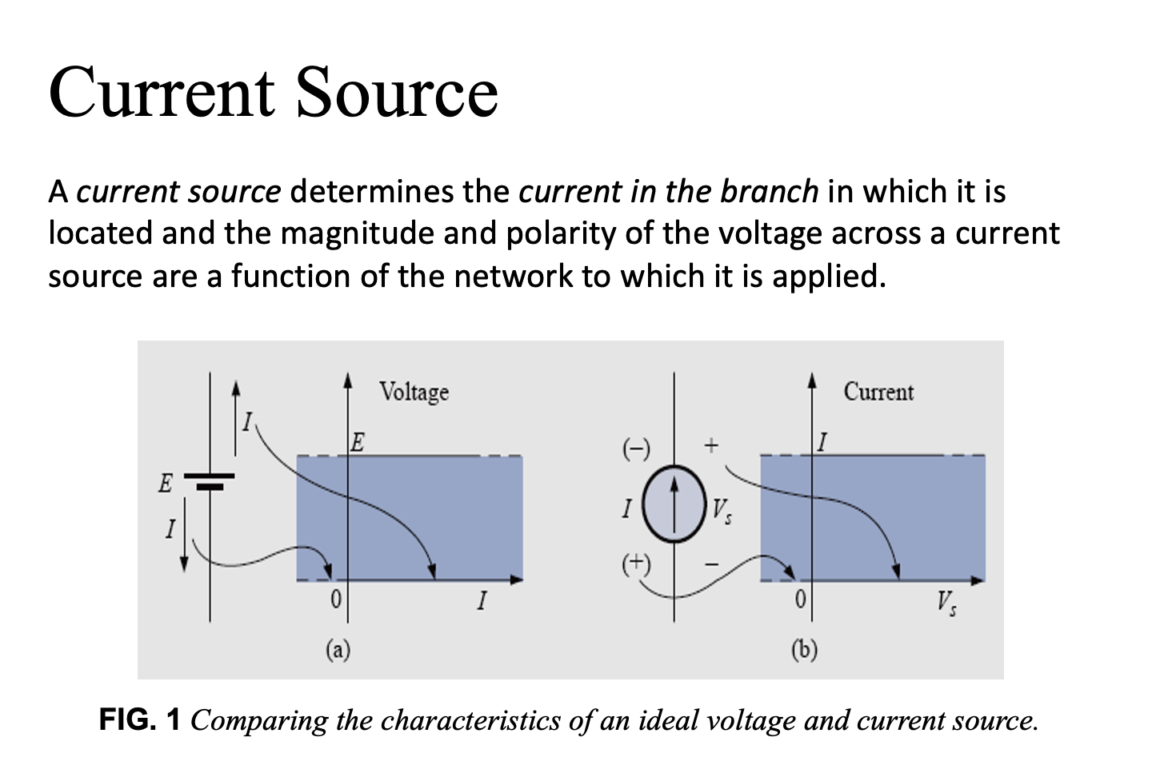
Chapter 8

Slide 4
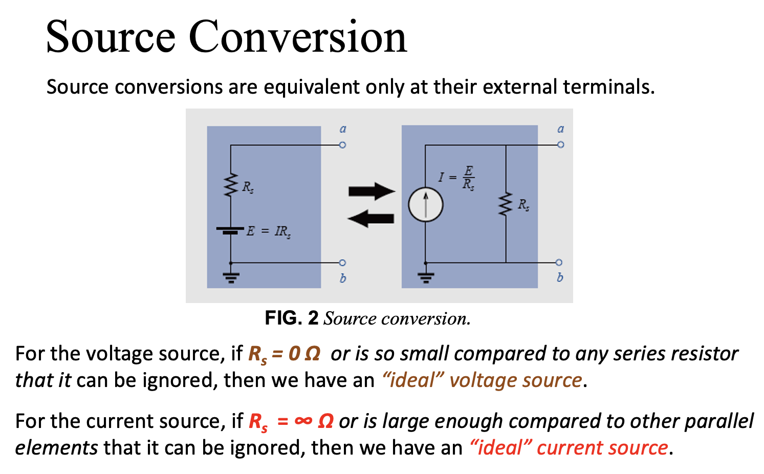
Chapter 8

Slide 5
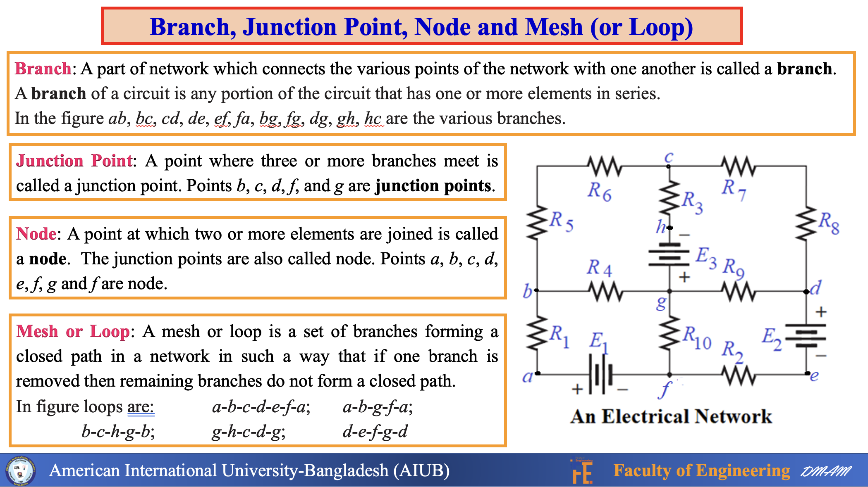

Slide 6
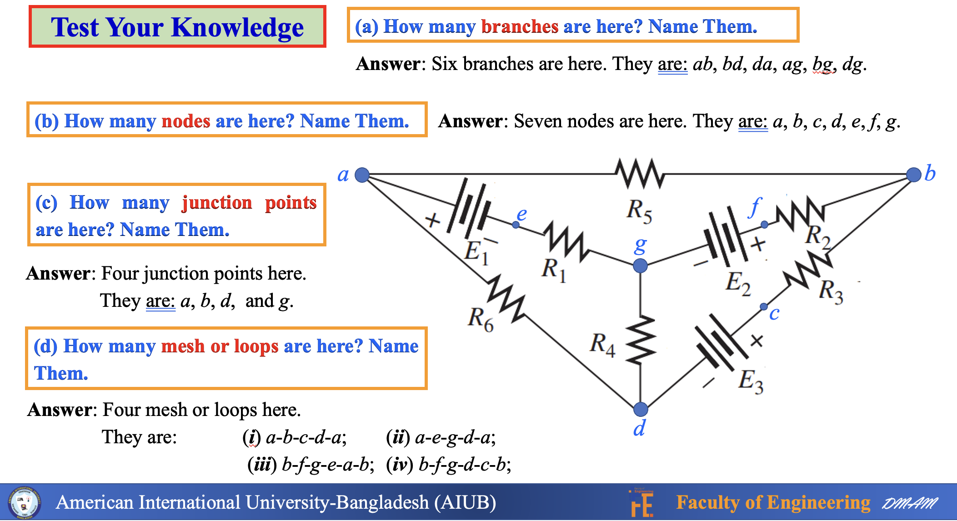

Slide 7
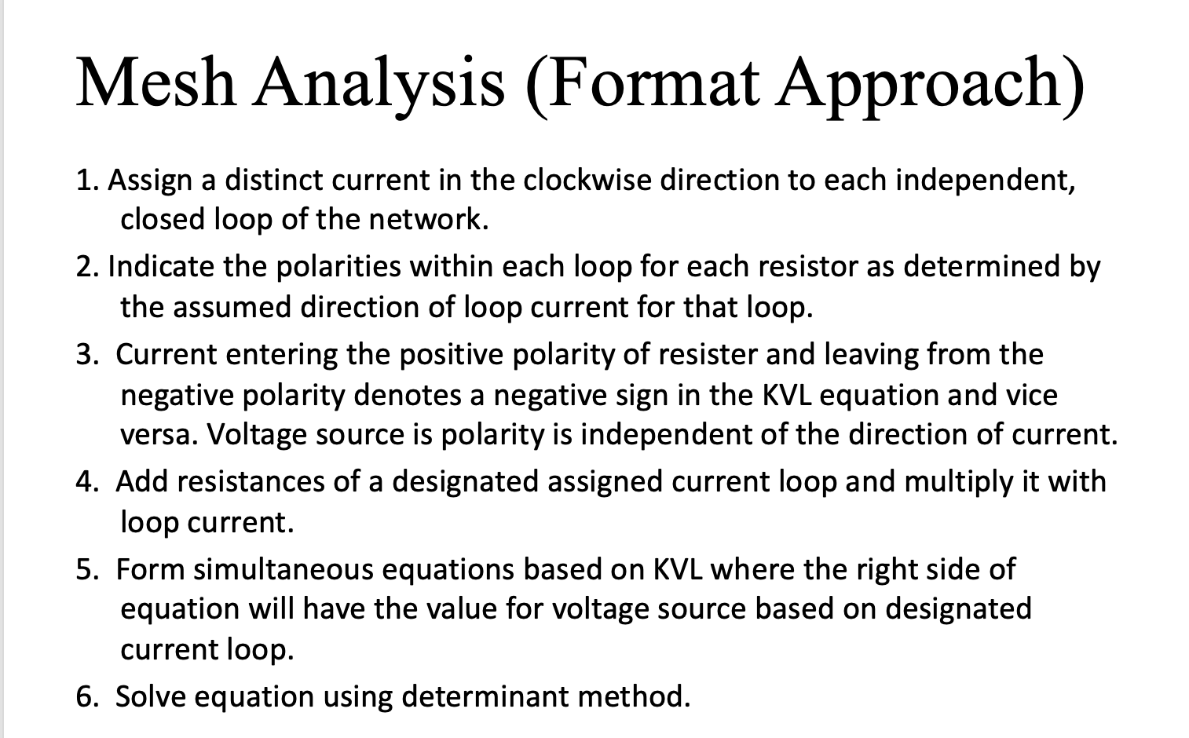
Chapter 8

Slide 8
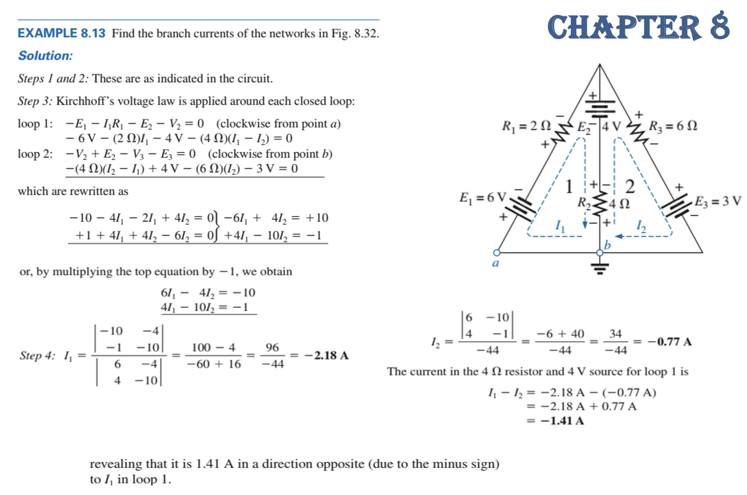
Chapter 8

Slide 9
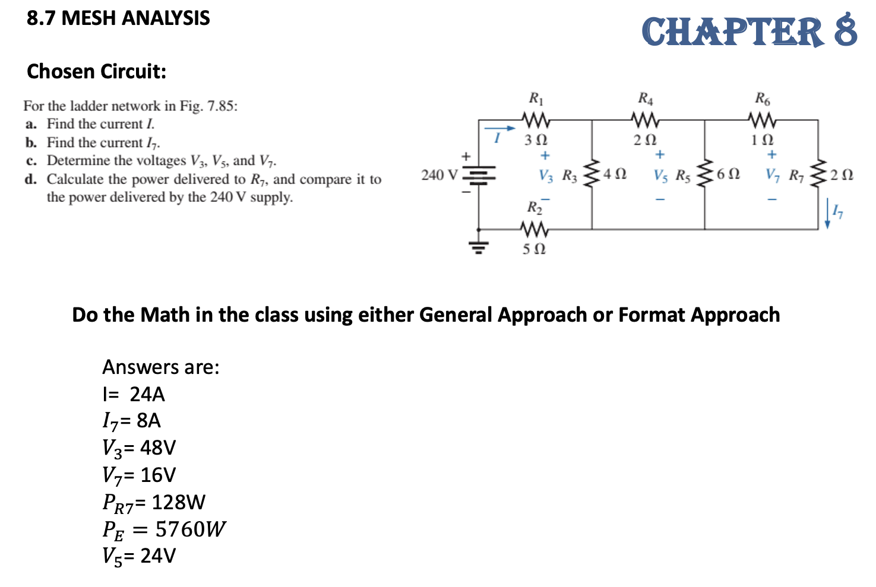
Chapter 8

Slide 10
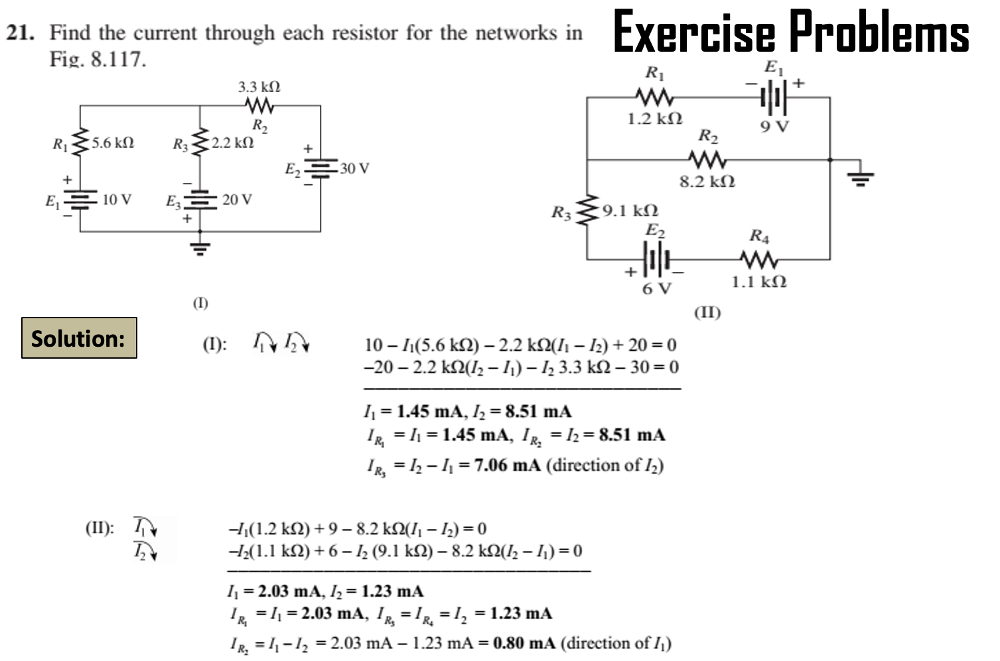
Chapter 8

Slide 11
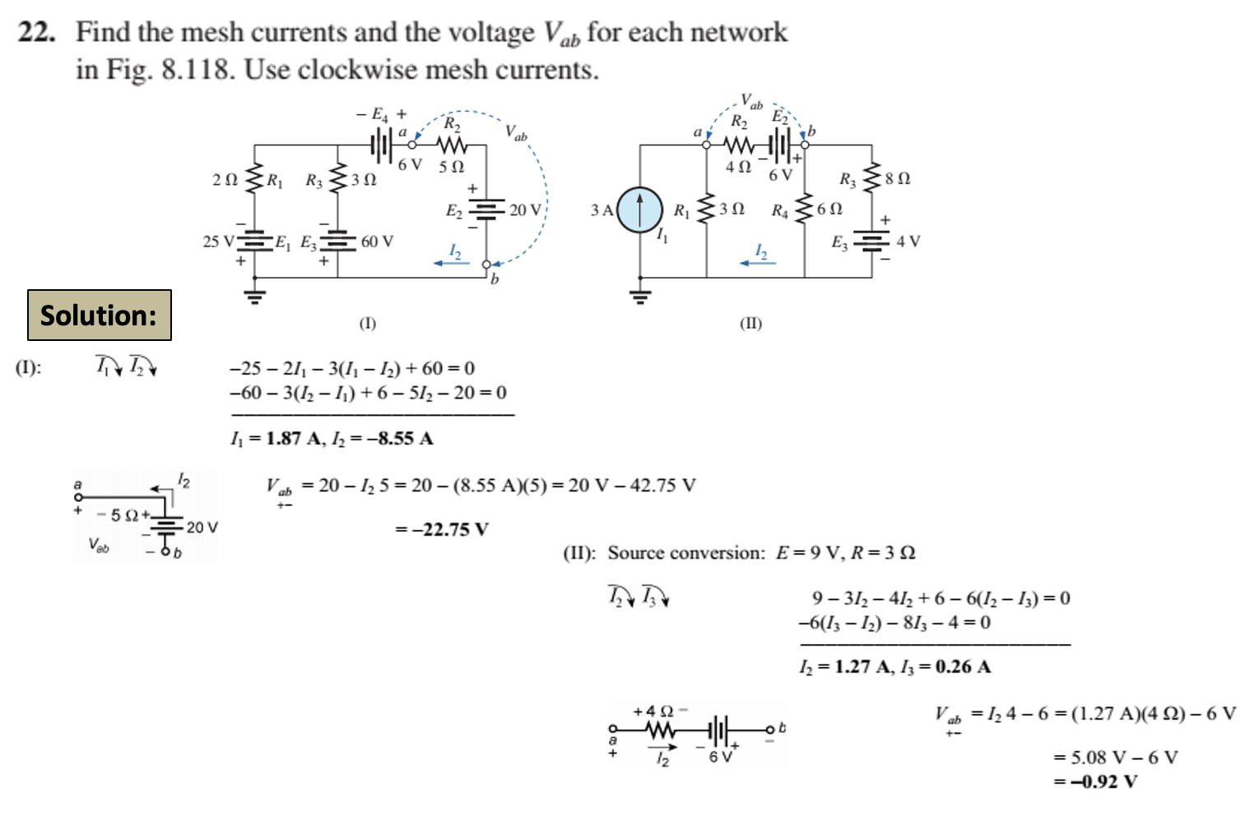
Chapter 8

Slide 12
Thank You

